Slide 1
Group 11
K Shreyas
Rajneesh Pandey
Satyarth Pandey

Slide 2
Asymptotic time and space complexity
Compare 2 given sorting algorithms => Compare raw timings? : bad idea because maybe different input/hardware/bad implementation/luck.
The time/space complexity of an algorithm quantifies the amount of time/space taken by an algorithm to run as a function of the length of the input.
Note that the complexity is a function of the length of the input and not the actual execution time of the machine on which the algorithm is running on.

Slide 3
Best, Worst, and Average Case Complexity
Suppose you are given a list L of some length len(L). Search an element E in this list.
Worst Case Complexity:
The function defined by the maximum number of steps taken on any instance of size n.
Linear in length of list.
Best Case Complexity:
The function defined by the minimum number of steps taken on any instance of size n.
Constant Time
Average Case Complexity:
The function defined by the average number of steps taken on any instance of size n.
Linear in length of list.

Slide 4
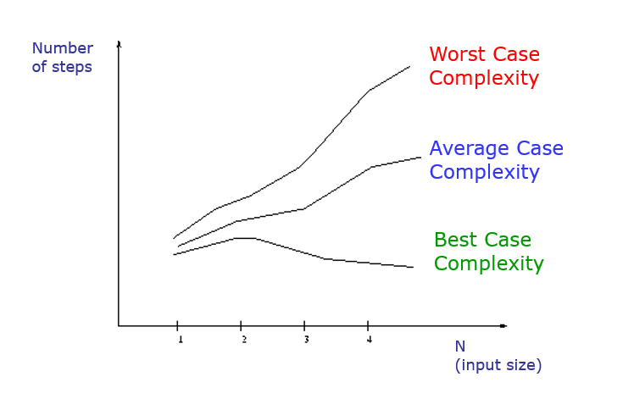
Best, Worst, and Average Case Complexity

Slide 5
Goal: to simplify analysis by getting rid of unneeded information (like “rounding” 1,000,001 ≈ 1,000,000)
We want to say in a formal way 3n² ≈ n²

Slide 6
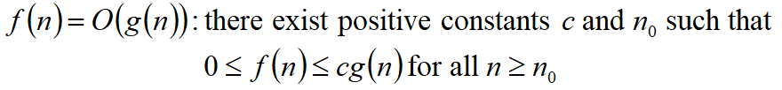
Big-O Notation
What does it mean!? :/
If f(n) = O(n²), then:
f(n) can be larger than n² sometimes, but…
We can choose some constant c and some value n₀ such that for every value of n larger than n₀ : f(n) < cn²
That is, for values larger than n₀ , f(n) is never more than a constant multiplier greater than n²
Or, in other words, f(n) does not grow more than a constant factor faster than n².

Slide 7
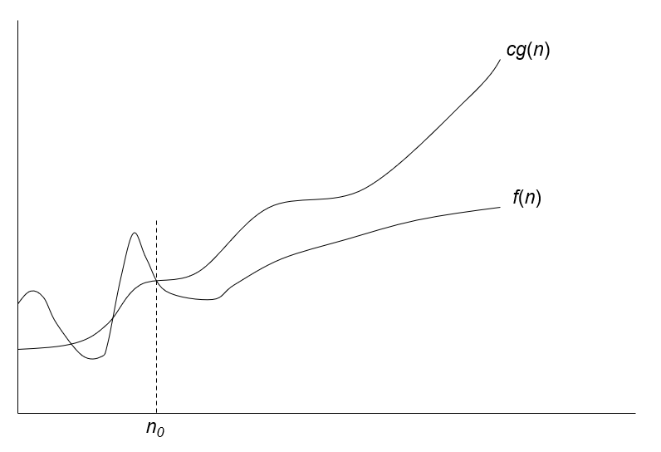
Visualization of O(g(n))

Slide 8
Examples
i) 2n² = O(n³) :
2n² ≤ cn³ => 2 ≤ cn => c = 1 and n₀= 2
ii) 1000n² + 1000n = O(n²) :
1000n² + 1000n ≤ cn² ≤ cn² + 1000n => c = 1001 and n₀ = 1

Slide 9
Note: Even though it is correct to say “7n - 3 is O(n³)”, a better statement is “7n - 3 is O(n)”, that is, one should make the approximation as tight as possible
Simple Rule: Drop lower order terms and constant factors
7n-3 is O(n)
8n²log n + 5n² + n is O(n²log n)

Slide 10
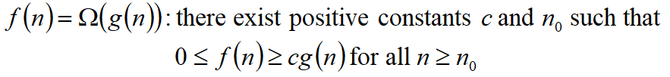
Big Omega Notation
Ω() – A lower bound
N ² = Ω(N)
Let c = 1, N₀ = 2
For all N >= 2, N ² > 1 x N

Slide 11
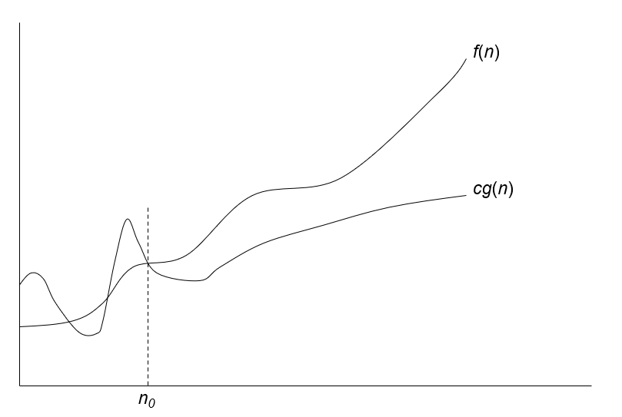
Visualization of Ω(g(n))

Slide 12
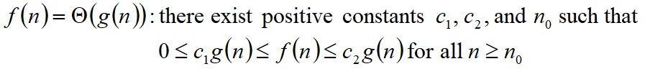
Theta - notation
Big-O is not a tight upper bound. In other words n = O(n²)
Θ provides a tight bound
In other words,

Slide 13
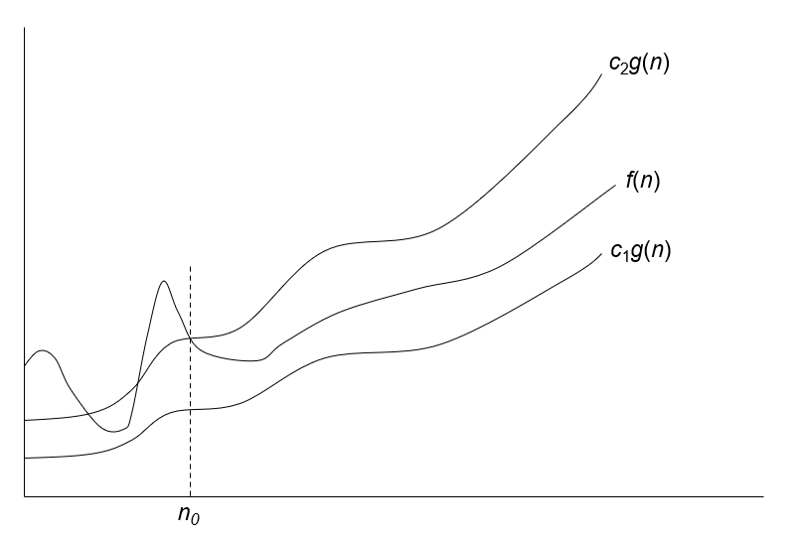
Visualization of Θ(g(n))

Slide 14
Few Examples
n = O(n²) ≠ Θ(n²)
200n² = O(n²) = Θ(n²)
n^{2.5} ≠ O(n²) ≠ Θ(n²)

Slide 15
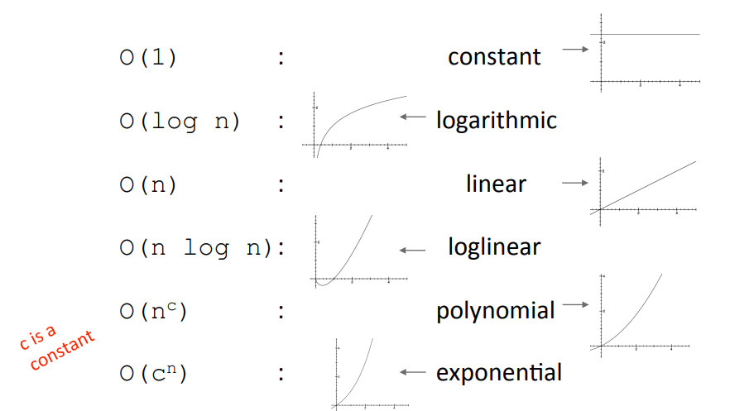
Popular Complexity Classes (order: low to high)

Slide 16
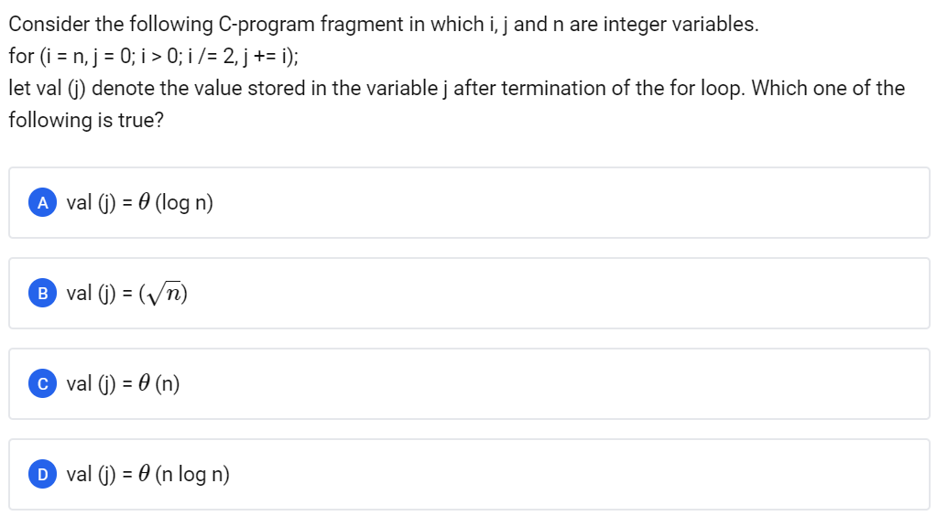
GATE CSE 2006

Slide 17
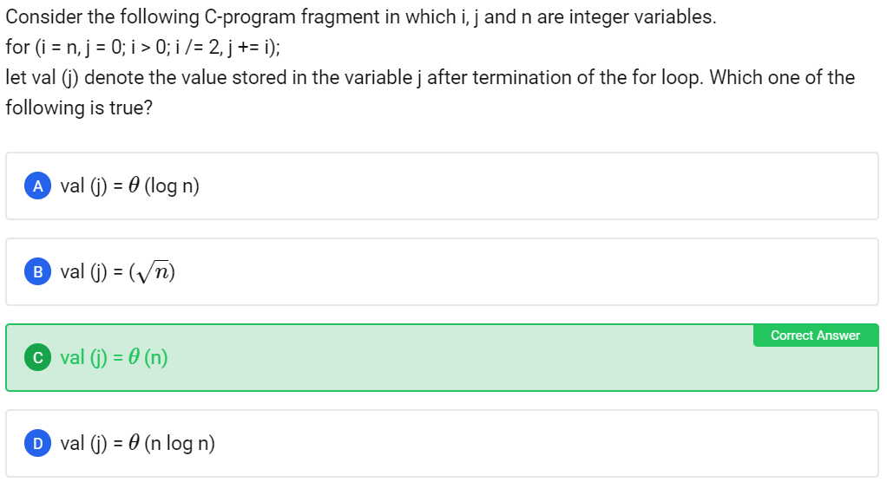
GATE CSE 2006
Explanation: n + n/2 + n/4 + n/8 + n/16 ...
<= 2 * n
Geometric Progression! :)

Slide 18
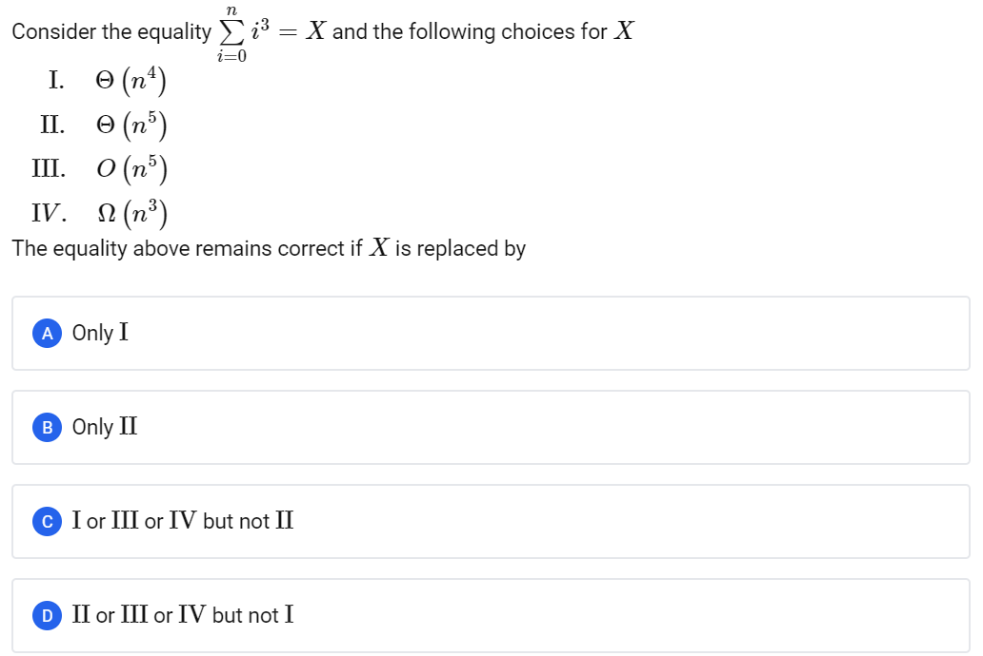
GATE CSE 2015 Set 3

Slide 19
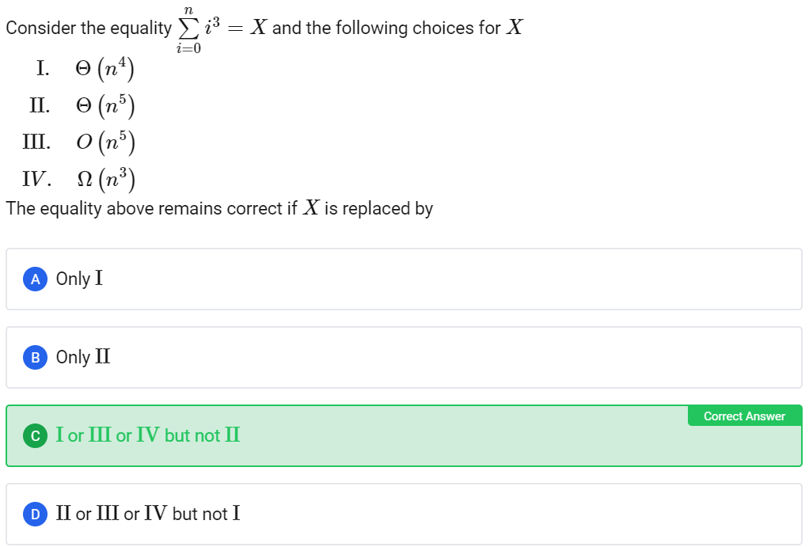
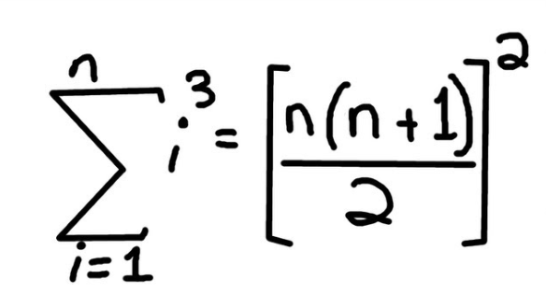
GATE CSE 2015 Set 3
Above we have a Θ(N ⁴) Complexity, which also further implies option III and IV

Slide 20
Recurrences
A recurrence is an equation that describes a function in terms of its value on smaller inputs.
For example: T(n) = T(n-1) + T(n-2)

Slide 21
Solving Recurrences
There are 3 methods to solve these recurrences and obtain a running time of an algorithm in terms of Big-Oh (O) notation:
Substitution: Guess a solution, verify by induction.
Recursion Tree: Draw a tree representing the recurrence and sum computation at nodes.
Master Theorem: A general formula to solve a large class of recurrences. More Reliable.

Slide 22
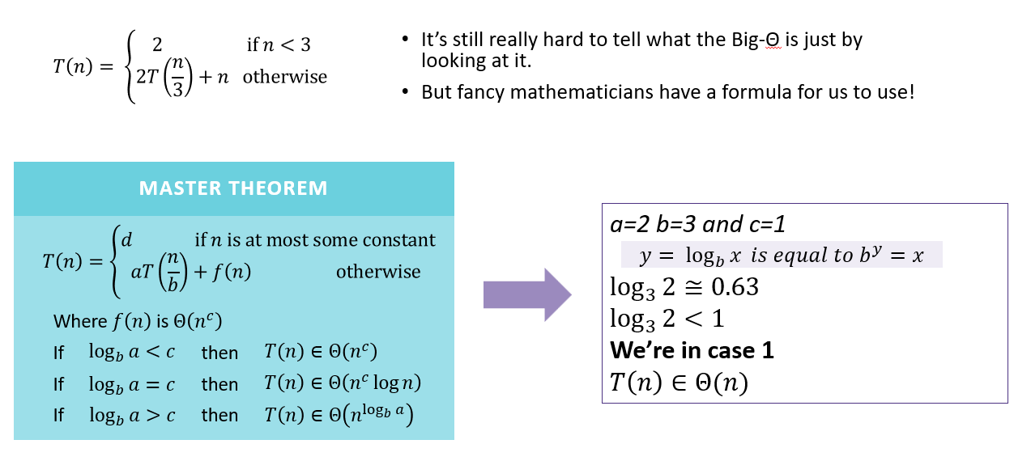
Master Theorem

Slide 23
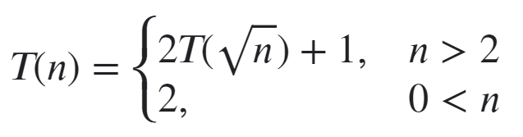
GATE CSE 2017 Set 2
Consider the recurrence function
Then T(N) in terms of θ notation is:
(A) θ (log log n)
(B) θ (log n)
(C) θ (sqrt(n))
(D) θ (n)

Slide 24
GATE CSE 2017 Set 2
Explanation:
T(n) = 2T(√n) + 1
Let n = 2^{m}
==> T(2^{m}) = 2T(2^{m/2}) + 1
Let S(m) = T(2^{m})
==> S(m/2) = T(2^{m/2})
Thus above equation will be :
S(m) = 2S(m/2)+1
Applying master’s theorem S(m) = Θ(m)
Thus : T(n) = Θ(log(n)) (since n = 2^{m})
Consider the recurrence function
Then T(N) in terms of θ notation is:
(A) θ (log log n)
(B) θ (log n) Correct Answer
(C) θ (sqrt(n))
(D) θ (n)

Slide 25
Searching, Sorting and Divide and Conquer Algorithms

Slide 26
Contents
Searching Algorithms:
Linear (Sequential) Search
Binary Search
Sorting Algorithms:
Bubble Sort
Insertion Sort
Selection Sorting
Heap Sort
Merge Sort
Quick Sort
Randomized
Divide & Conquer Algorithms:
BinarySearch, Merge-sort, Quicksort
Multiplication of large integers
Matrix multiplication:
Strassen’s algorithm
Closest-pair algorithms

Slide 27
Searching Algorithms
01. Linear (Sequential) Search:
It finds an item in an array by looking for it from the beginning till the end. Without any assumption about the array.
Worst case Analysis of Sequential Search:
Occurs when the search term is the last element in the array or not present.
The number of comparisons in worst case = size of the array = n.
Time complexity = O(n)

Slide 28
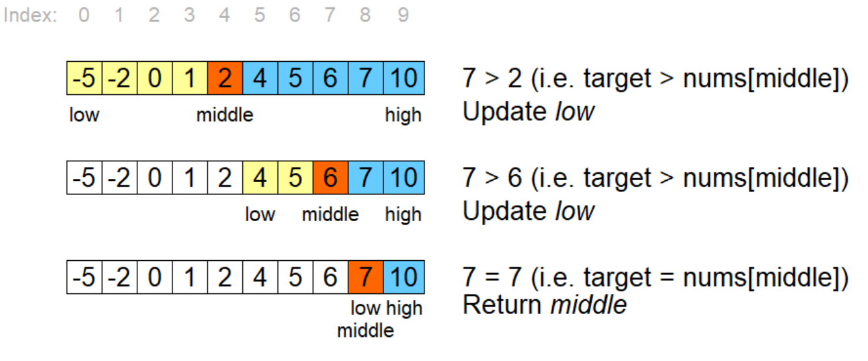
02. Binary search
Assumes the list is already in order.
In each step
Finds the Middle element
Considers only left side or right side elements according to condition.
Worst-case analysis
When search term is
-not in the list, or
-one item away from the middle,
-first or last item in the list.
Maximum number of comparisons
(log(n))+1
Time complexity = O(log(n))

Slide 29
Sorting Algorithms
Types of sorting:
Based on Complexity, Stability, comparison, etc.
In-place Sorting:
The In-place sorting algorithm does not use extra storage to sort the elements in the given list.
Stable Sorting:
Stable sorting algorithm maintain the relative order of records with equal values during sorting the elements.
Comparison based sorting:
It determines that ,which of two elements being compared should occur first in the final sorted list.

Slide 30
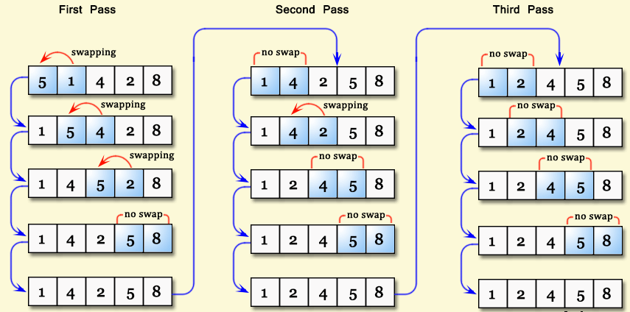
Bubble Sort
Repeatedly steps through the list, compares adjacent elements and swaps them if they are in the wrong order until the list get sorted.
It can be optimized by stopping the algorithm if the inner loop didn’t cause any swap
Time Complexity:
Best case: O(n)
Average case: O(n^2)
Worst case : O(n^2)
Last i elements will be sorted in every i Pass.

Slide 31
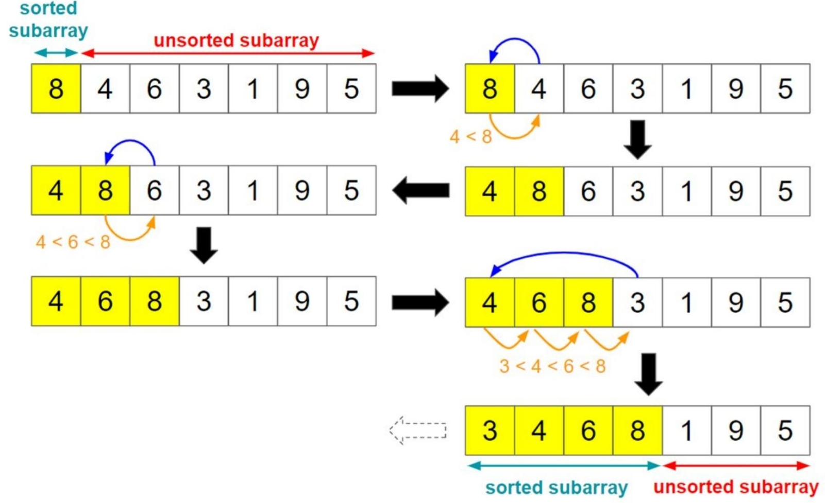
Insertion Sort
Iterates through an array and repeatedly inserts each element into its sorted position within a growing sorted subarray.
Time Complexity:
Best case: O(n) (sorted)
Average case: O(n^2)
Worst case : O(n^2)
(Reverse sorted)
Useful only for small files or very nearly sorted files.
It is comparison based, in-place and stable algorithm.

Slide 32
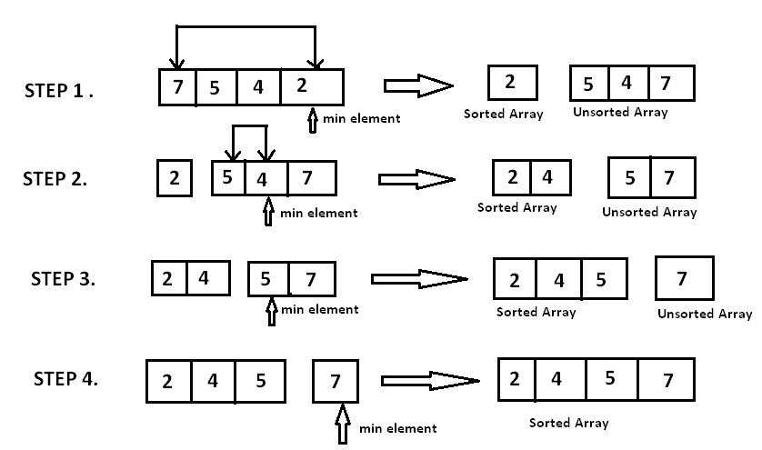
Selection Sort
Repeatedly selects the minimum element from an unsorted list and places it at the beginning of the list until the whole list is sorted.
Time Complexity:
Best case: O(n^2)
Average case: O(n^2)
Worst case : O(n^2)
It in-place, comparison sorting algorithms

Slide 33
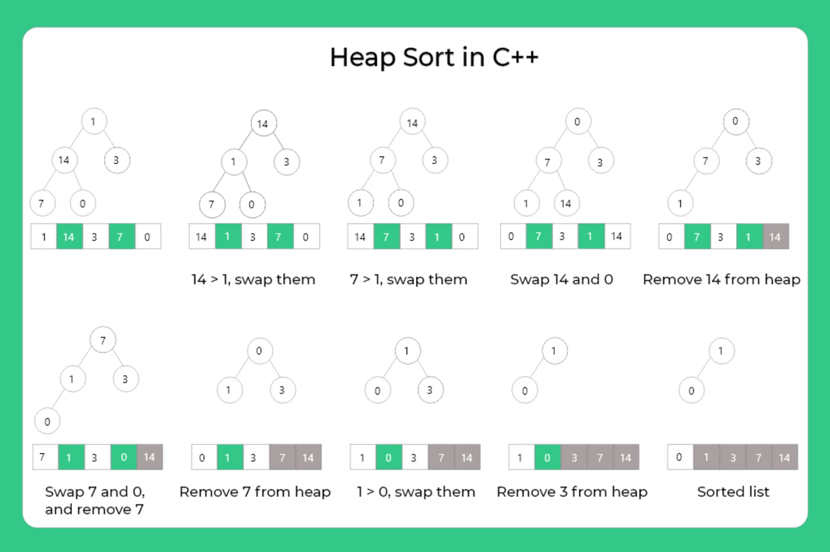
Heap Sort
Comparison-based sorting algorithm that uses a binary heap data structure to sort elements in ascending or descending order
Max heap: parent>children.
Time Complexity: O(nlogn)
Build-Heap: O(n) time.
Heapify: O(logn) time.
Top to bottom
Extract-Max: O(logn) time.
It is comparison based, in-place and non-stable algorithm.

Slide 34
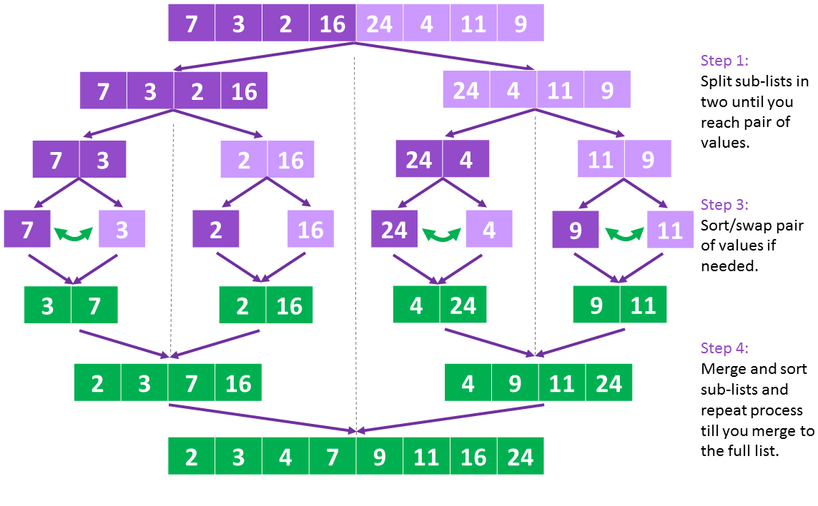
Merge Sort
It's a divide-and-conquer algorithm that recursively divides a list into two halves, sorts them independently, and then merges them back together into a sorted list.
Time Complexity:
T(n) = 2T(n/2)+ O(n)
Best Case: O(nlogn)
Average case: O(nlogn)
Worst Case: O(nlogn)
It is comparison based, and stable algorithm.
Application:
Count Inversion in array

Slide 35
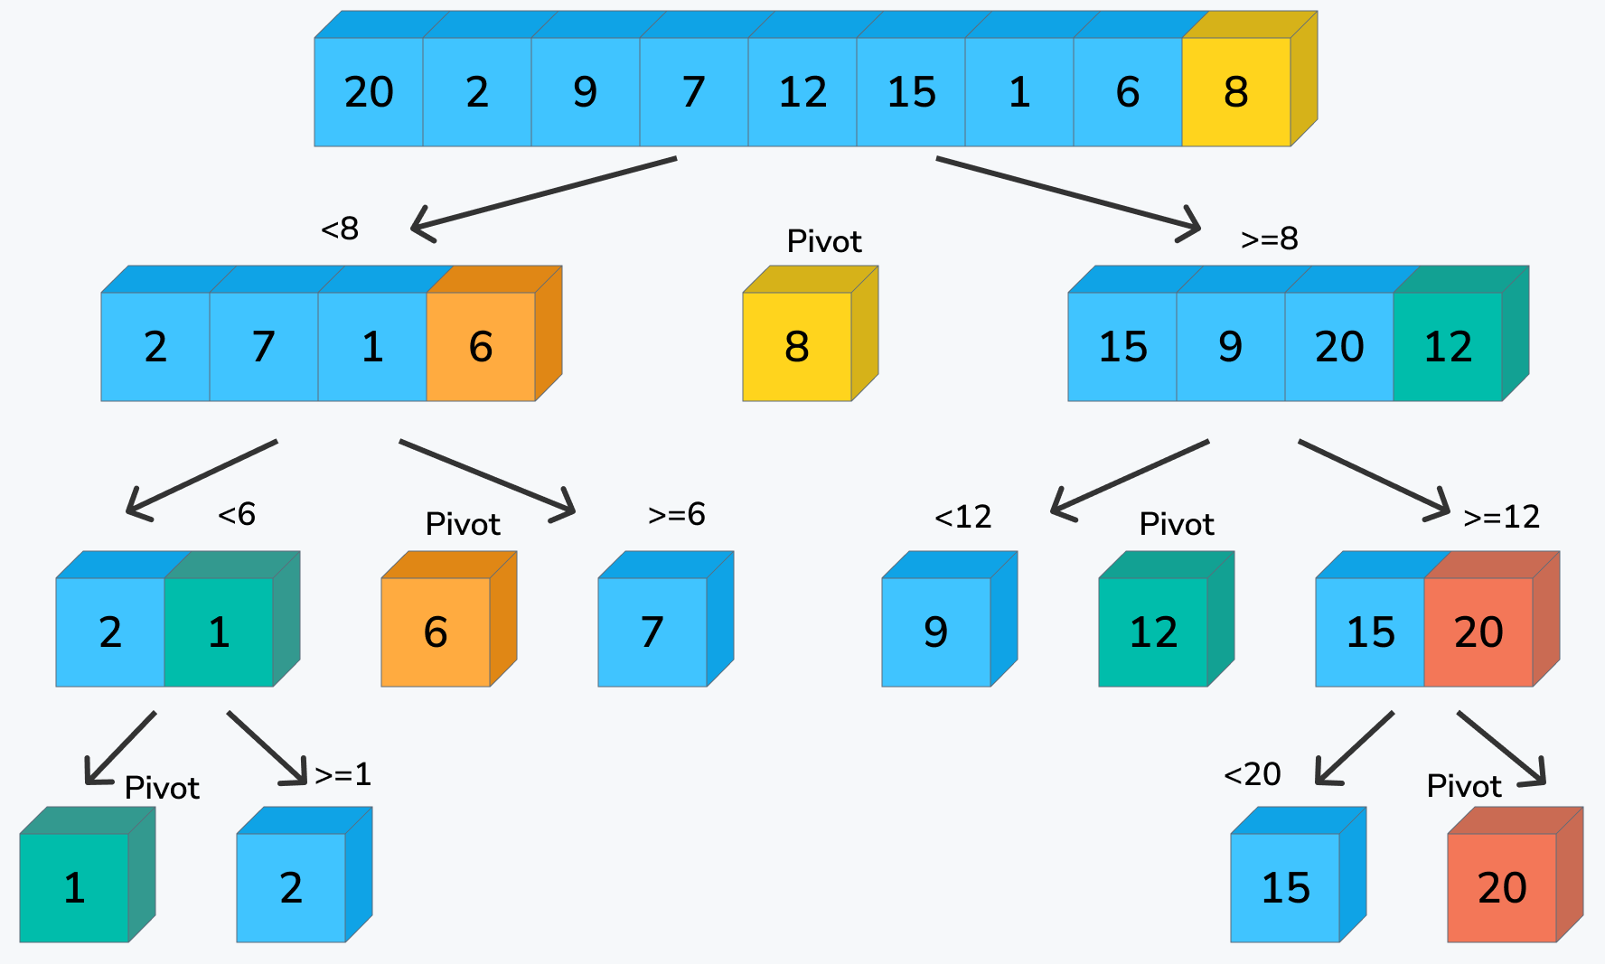
Quick Sort (Partition exchange sort.)
Comparison-based algo. that uses a divide-and-conquer approach by selecting a pivot element and partitioning the array into smaller sub-arrays.
Time Complexity:
T(n) = T(n-1)+T(1)+cn
Best-Average case: O(nlogn)
Worst case : O(n^2)
(sorted/Reverse-sorted/all equal)
It is in-place sorting algo
Randomized quick sort is a variant of this that selects a random pivot element to avoid worst-case scenarios and improve average-case performance.

Slide 36
Problems
Q1. In a binary max heap containing n numbers, the smallest element can
be found in time?
O(n)
O(logn)
O(1)
O(log(logn))
Correct ans: A
In max heap, the smallest element should not have any children so it will be present in the leaf node. And to find the smallest element you have to go to the leaf and find minimum among them.
In a heap leaf node starts from floor(n/2)+1 and end at n. So no of leaf nodes present in the heap is O(n/2). So total no of comparison needed in order to find the smallest element is n and the time taken for that will be O(n).

Slide 37
Q2. There are two sorted list each of length n. An element to be searched in the both the lists. The lists are mutually exclusive. The maximum number of comparisons required using binary search and find its time complexity?
O(n)
O(logn)
O(n*n)
O(log(logn))
Correct ans: B
Suppose searching element=X
First apply the BINARY search in array 1, if element found then well and good, TC will be O(logn). But, If element not found in array 1,then apply the Binary search in array2,again in will take logn time ,but
Now,overall time must be 2logn but asymptotically the TC WILL BE = ○(logn)

Slide 38
Q.3. An element in an array X is called a leader if it is greater than all
elements to the right of it in X. The best algorithm to find all leaders
in an array.
Solves it in linear time using a left to right pass of the array
Solves it in linear time using a right to left pass of the array
Solves it using divide and conquer in time Theta(nlogn)
Solves it in time Theta(n^2)
Correct ans: B
Let max = arr[n-1], then
Traverse from right to left and add arr[i] to Leader if (arr[i]>max) and update max=arr[i]

Slide 39
Q.4 Give the correct matching for the following pairs:
Group - 1
O(logn)
O(n)
O(nlogn)
O(n*n)
Group - 2
(P) Selection
(Q) Insertion sort
(R) Binary search
(S) Merge sort
Correct Ans: A – R , B – Q, C – S, D – P
Best case time complexity
Selection sort : O(n*n)
Merge sort : O(nlogn)
Binary search : O(logn)
Insertion sort : O(n)

Slide 40
Hashing
A hash function is any function that can be used to map data of arbitrary size to fixed-size values. Use of a hash function to index a hash table is called hashing.
A good hash function should have following properties:
Efficiently computable.
Should uniformly distribute the keys
Should minimize collisions.
Should have a low load factor.

Slide 41
Load factor = (number of keys) / (number of slots in the table)

Slide 42
Collision Resolution by Separate Chaining
If multiple keys index to the same slot using a hash function, maintain a data structure at each slot of the table to contain multiple elements, such as a linked list, dynamic array or a balanced BST.

Slide 43
Collision Resolution by Open Addressing
Linear Probing: If a key hashes to an occupied slot in the table, put it in the next available slot by traversing through the table indices in steps of 1 (n + 1, n + 2, n + 3, etc).
Quadratic Probing: If a key hashes to an occupied slot in the table, put it in the next available slot by traversing through the table indices in steps of square numbers (n + 1, n + 4, n + 9, etc).
Double Hashing: If a key hashes to an occupied slot in the table, put it in the next available slot by traversing through the table indices in steps of a secondary hash function (n + h₂(x), n + 2h₂(x), n + 3h₂(x), etc).

Slide 44
GATE Questions
1. Suppose we are given n keys, m has table slots, and two simple uniform hash functions h1 and h2. Further suppose our hashing scheme uses h1 for the odd keys and h2 for the even keys. What is the expected number of keys in a slot?

Slide 45
GATE Questions
1. Suppose we are given n keys, m has table slots, and two simple uniform hash functions h1 and h2. Further suppose our hashing scheme uses h1 for the odd keys and h2 for the even keys. What is the expected number of keys in a slot?
Ans: n / m

Slide 46
GATE Questions
2. Consider a double hashing scheme in which the primary hash function is h1(k )= k mod 23, and the secondary hash function is h2(k) = 1+(k mod 19). Assume that the table size is 23. Then the address returned by probe 1 in the probe sequence (assume that the probe sequence begins at probe 0) for key value k=90 is _______.

Slide 47
GATE Questions
2. Consider a double hashing scheme in which the primary hash function is h1(k )= k mod 23, and the secondary hash function is h2(k) = 1+(k mod 19). Assume that the table size is 23. Then the address returned by probe 1 in the probe sequence (assume that the probe sequence begins at probe 0) for key value k=90 is _______.
Ans:
h1(90) = 90 mod 23 = 21. We assume that 21 is occupied, hence probe 1 is needed.
h2(90) = 1 + (90 mod 19)= 15.
So the next probe location would be at (21 + 15) mod 23 = 36 mod 23 = 13.

Slide 48
GATE Questions
3. A hash table contains 10 buckets and uses linear probing to resolve collisions. The key values are integers and the hash function used is key % 10. If the values 43, 165, 62, 123, 142 are inserted in the table, in what location would the key value 142 be inserted?

Slide 49
GATE Questions
3. A hash table contains 10 buckets and uses linear probing to resolve collisions. The key values are integers and the hash function used is key % 10. If the values 43, 165, 62, 123, 142 are inserted in the table, in what location would the key value 142 be inserted?
Ans:
43 ->3; 165 -> 5; 62 -> 2; 123 -> 3 -> 4
142 -> 2 -> 3-> 4-> 5 -> 6

